Slide 1
Prediction of Brain Stroke using Machine Learning
Guide:
Prof. Bhavyashree H D
Dept of ISE
Presented by:
Amarnath R(4MH21IS006)
Ankith TP(4MH21IS011)
Jagath Ponnanna P M(4MH21IS116)
Sandesh K M(4MH22IS416)

Slide 2
Content
Project Synopsis
Title
Introduction
Existing Systems and their drawbacks
Problem Statement
Proposed Solution / Objectives
Software Requirement Specification
Block Diagram
Module Description
Applications
References

Slide 3
Project Synopsis
Content Overview
Introduction
Improved model accuracy using feature selection
Implementation of multiple ML algorithms for better prediction
A user-interface to input data and receive stroke risk assessment

Slide 4
Content Overview
Project Synopsis
2. Existing Systems and their drawbacks
Limited Accuracy in Existing Methods
Assumption of Feature Independence
High False Positive and Negative Rates

Slide 5
Content Overview
Project Synopsis
3. Problem Statement
“ Stroke is the second leading cause of death worldwide. Stroke prediction is complex because it is dependence on numerous factors. A high stroke probability in data does not guarantee its occurrence due to genetic and biological factors ”

Slide 6
Content Overview
Project Synopsis
4. Proposed Solution / Objectives
Achieve accurate stroke prediction using machine learning models.
Enhance model performance using data preprocessing techniques like feature selection

Slide 7
Content Overview
Project Synopsis
4. Proposed Solution / Objectives
Reduce false positives and false negatives to improve reliability.
Create a user-interface for easy accessibility.

Slide 8
Content Overview
Project Synopsis
5. Software Requirement Specification
Programming Language: Python
Libraries: TensorFlow, scikit-learn, Pandas
Functional Requirements:
-Implement machine learning models
-Perform real-time stroke prediction based on input data
-Allow data preprocessing, feature selection, and model evaluation.

Slide 9
Content Overview
Project Synopsis
5. Software Requirement Specification
Non-functional Requirements:
Scalability
Performance
Usability
Maintainability

Slide 10
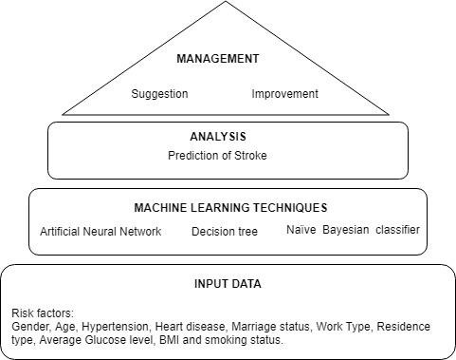
Content Overview
Project Synopsis
6. Block Diagram

Slide 11
Content Overview
Project Synopsis
7. Module Description
Data Preprocessing: Data cleaning, handling missing values, feature selection
Model Training and Testing: Training different machine learning models the prepared dataset
Model Selection: Best-performing model is selected for prediction
Prediction and Visualization: Predict the probability of a brain stroke and provide visual insights.

Slide 12
Content Overview
Project Synopsis
8. Applications
Healthcare Providers
Personal Health Monitoring
Hospitals & Clinics
Public Health Campaigns
Health and Wellness Apps

Slide 13
Content Overview
Project Synopsis
9. References
[1]. “Computer Methods and Programs in the Biomedicine” - Jae–woo Lee, Hyun-sun Lim, Dong-wook Kim, Soon-ae Shin, Jinkwon Kim, Bora Yoo
[2]. “Probability of Stroke: A Risk Profile from the Framingham Study” - Philip A. Wolf, MD; Ralph B. D'Agostino, PhD, Albert J. Belanger, MA; and William B. Kannel, MD
[3]. “Development of an Algorithm for Stroke Prediction: A National Health Insurance Database Study” - Min SN, Park SJ, Kim DJ, Subramaniyam M
[4]. “Stroke prediction using artificial intelligence”- M. Sheetal Singh, Prakash Choudhary
[5]. “Medical software user interfaces, stroke MD application design (IEEE)” - Elena Zamsa

Slide 14
Content Overview
Project Synopsis
9. References
[5]. “Medical software user interfaces, stroke MD application design (IEEE)” - Elena Zamsa
[6]. “Focus on stroke: Predicting and preventing stroke” - Michael Regnier
[7]. “Effective Analysis and Predictive Model of Stroke Disease using Classification Methods” - A.Sudha, P.Gayathri, N.Jaisankar
[8]. “Deep learning algorithms for detection of critical findings in head CT scans: a retrospective study” - Rohit Ghosh, Swetha Tanamala, Mustafa Biviji, Norbert G Campeau, Vasantha Kumar Venugopal
[9] "Stroke Prediction Using Machine Learning Techniques: A Survey," S. Patil, N. Shinde, and P. R. Patil, International Journal of Computer Applications

Slide 15
Thank you

Slide 16
Queries?

